Slide 1
GANIT TIMES: A Real-Time Newspaper
Capstone Project
Team:
Adnan Abdul Salam Mohamed
Deepanshu Gond
Yukta Maheswari
16 August 2024

Slide 2
Agenda
Objective
Solution approach
Overview of data retrieval
Exploratory Data Analysis
Data Dictionary
Services Used
Implemented Architecture
Snapshot of the dashboards

Slide 3
Objective
To develop a visual newspaper dashboard by leveraging data fetched from the Inshorts API.
The project involves studying and cleaning the raw data to ensure accuracy and relevance, followed by creating an intuitive and user-friendly dashboard that updates every day.
The goal is to enable users to explore and interact with the latest news in a concise, visually appealing format.

Slide 4
Solution approach
Load data from the given API URL to a S3 bucket.
Analyze the data – trends, anomalies.
Do an exploratory data analysis to determine what all data is needed.
Write a glue job to extract the data that is needed.
Develop an ETL pipeline on AWS to pull the updated data from the API daily at a fixed time and load it onto the dashboarding software.
Automate the pipeline.
Build a live dashboard using any BI tool (Tableau/Quicksight).

Slide 5
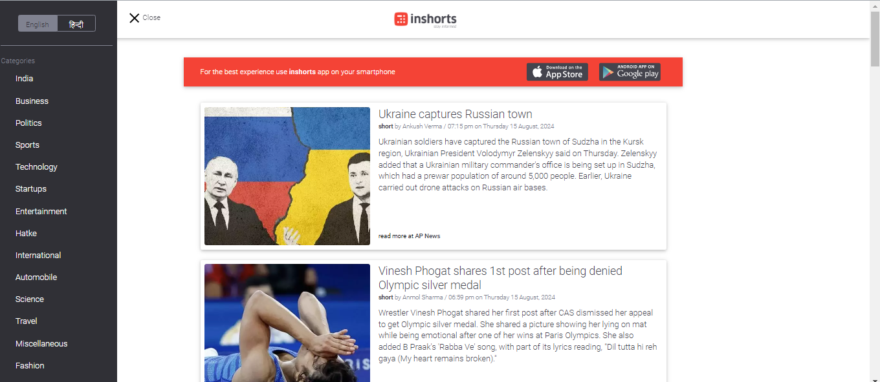
Overview of the data retrieval
Inshorts is a news app that provides concise news summaries in a short, easy-to-read format.
We were provided with an API offering free non-commercial access to daily news data.

Slide 6
Exploratory Data Analysis
Imported the necessary libraries
Made a sample dataframe containing all the variables from the API to analyze and select the most relevant variables while making the real one.
Noticed that the API loaded data with nulls in many columns.
Wrote a code to remove the unwanted columns and made the real dataframe.

Slide 7
Data Dictionary
Finally, the following parameters were chosen based on their relevance to a newspaper dashboard and their correlation between other variables:
Column | Description | Data Type
category | The category under which the news article falls, vis. FINANCE, BUSINESS, TECHNOLOGY, STARTUP. | string
rank | Index of a particular category starting from 0. | integer
content | The main text content or body of the news article. | string
source_url | The URL where the original news article can be found. | string
source_name | Name of the source/publication (company) from whose URL the news article was sourced. | string
title | The title or headline of the article. | string
image_url | URL of the image associated with the news article. | string
impressive_score | A score possibly related to the impact or engagement of the article. | float
created_at | The time when the news article was created at the source site. | datetime

Slide 8
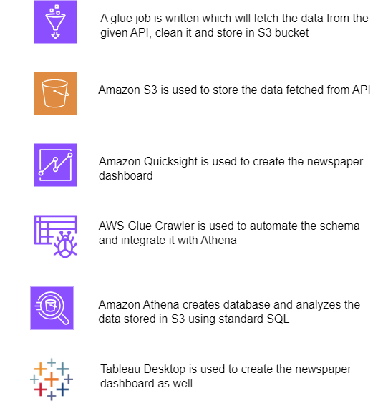
Services Used

Slide 9
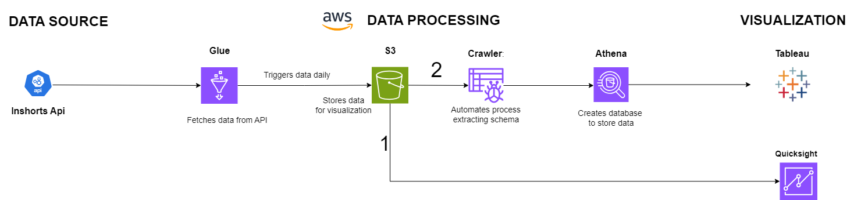
Implemented Architecture

Slide 10
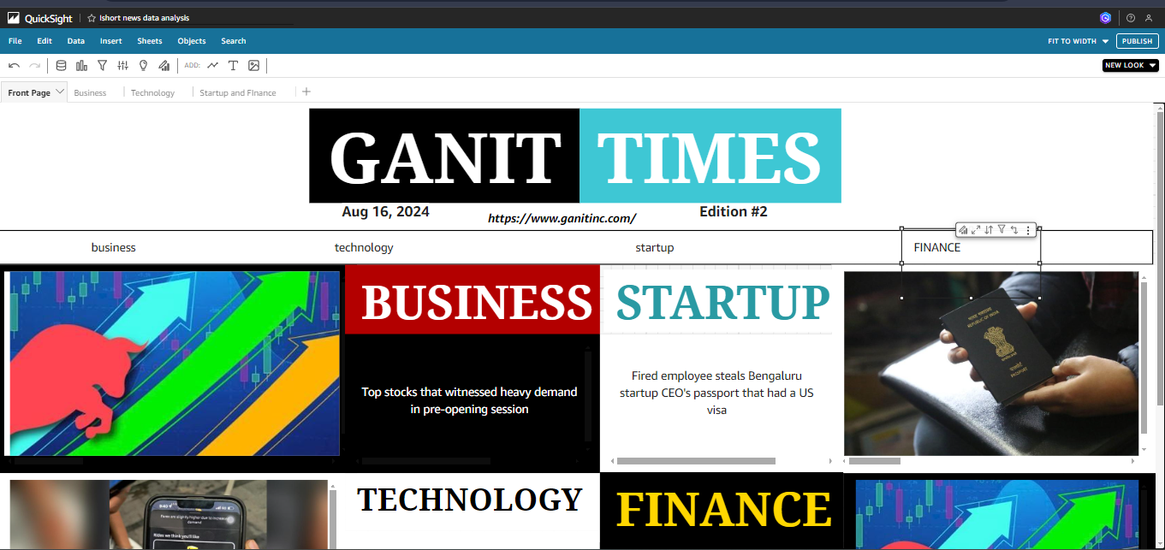
Snapshot of the dashboards

Slide 11
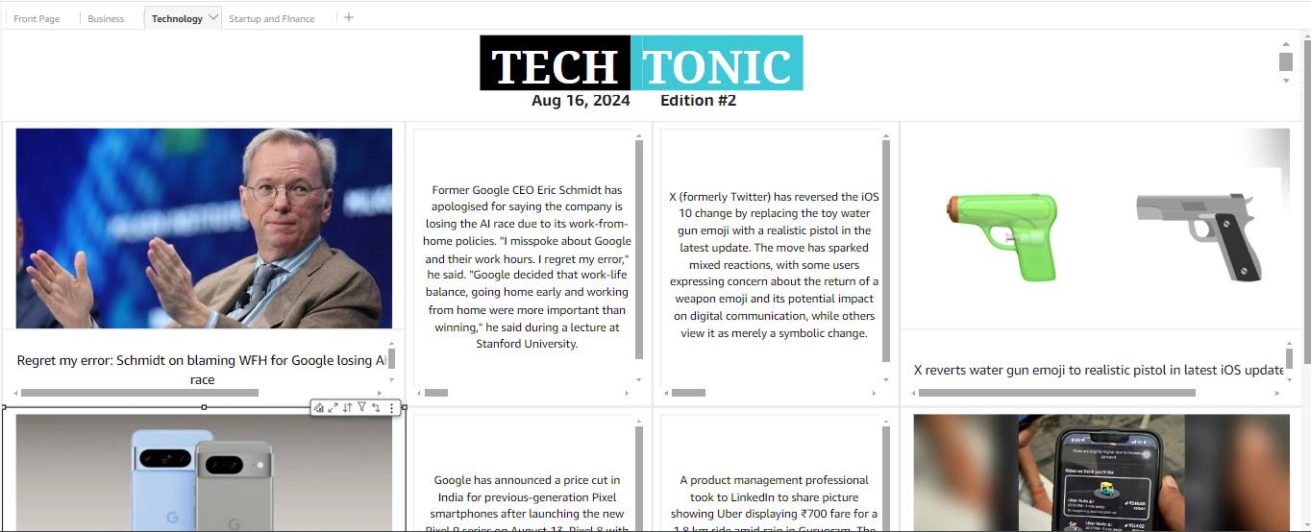
Snapshot of the dashboards

Slide 12
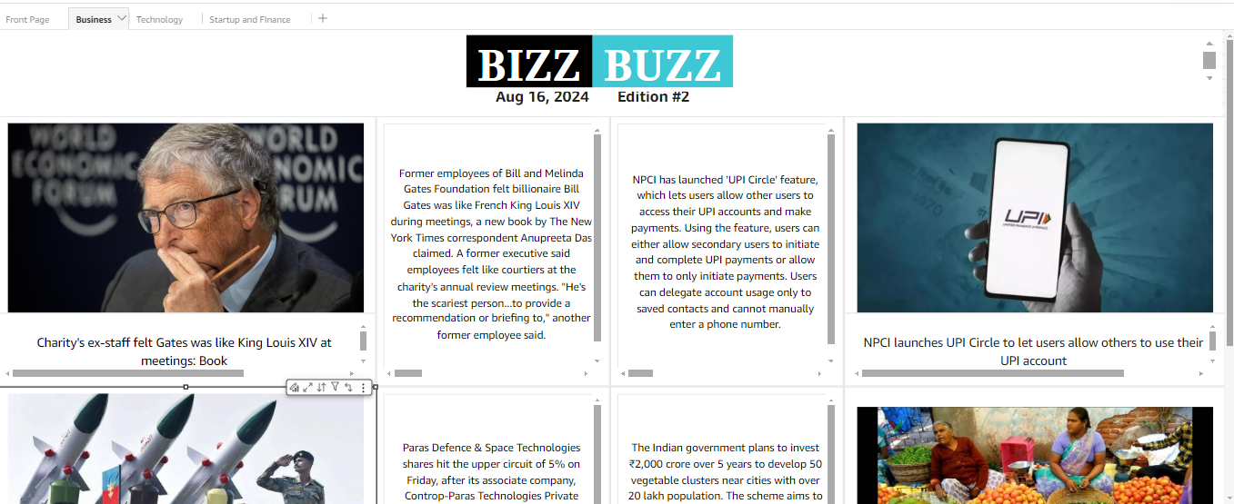
Snapshot of the dashboards

Slide 13
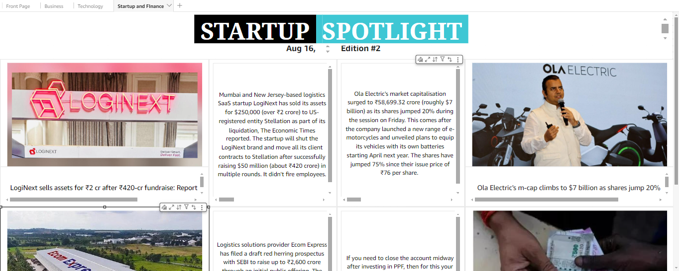
Snapshot of the dashboards

Slide 14
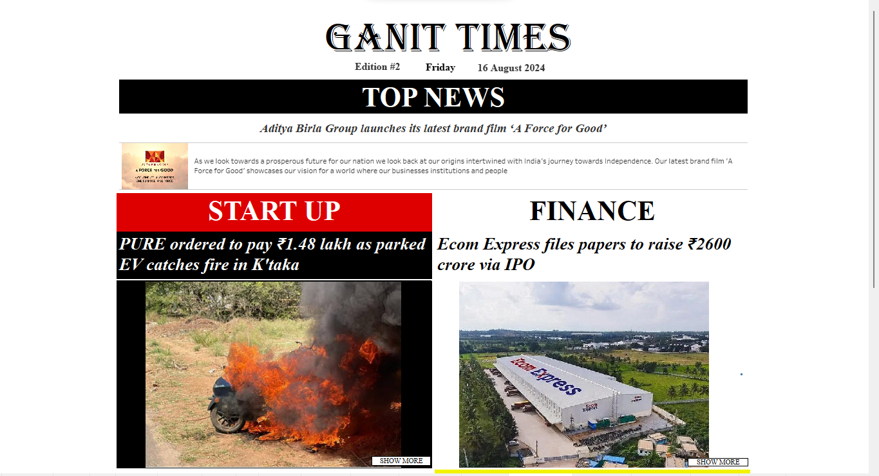
Snapshot of the dashboards

Slide 15
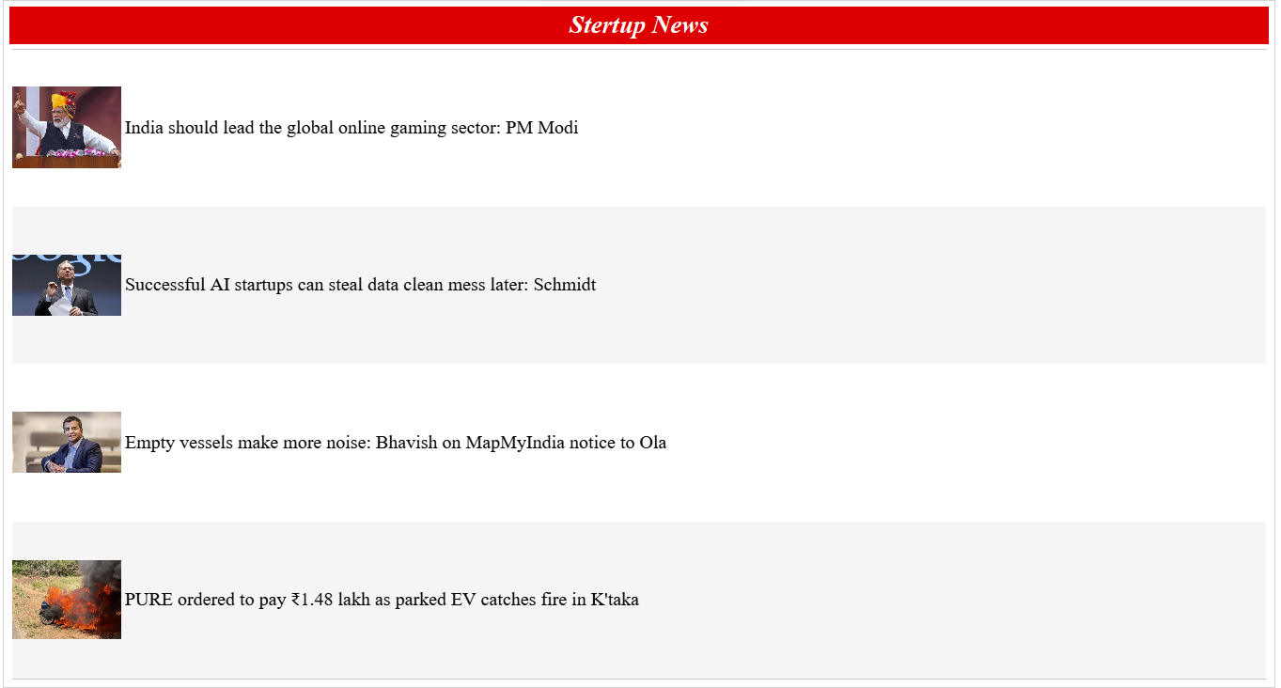
Snapshot of the dashboards

Slide 16
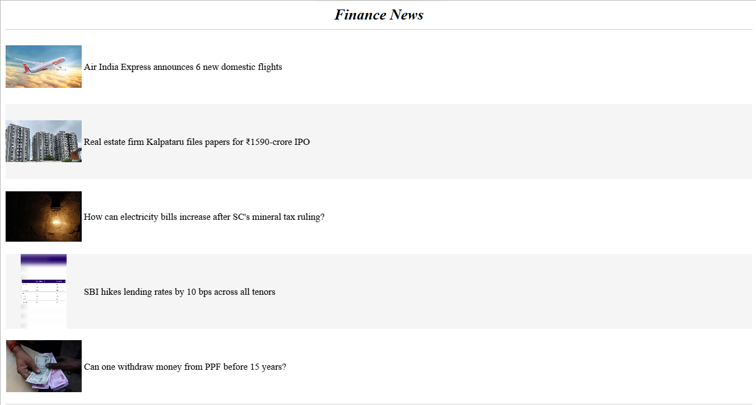
Snapshot of the dashboards

Slide 17
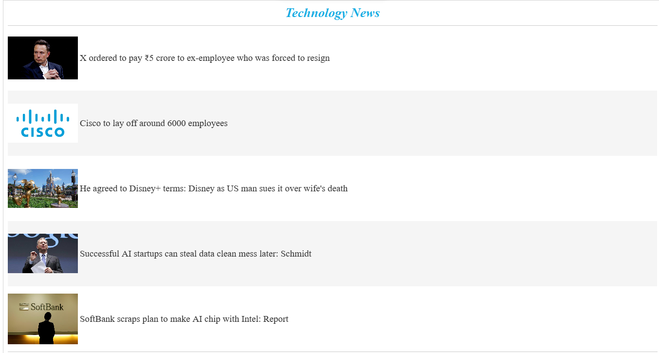
Snapshot of the dashboards

Slide 18
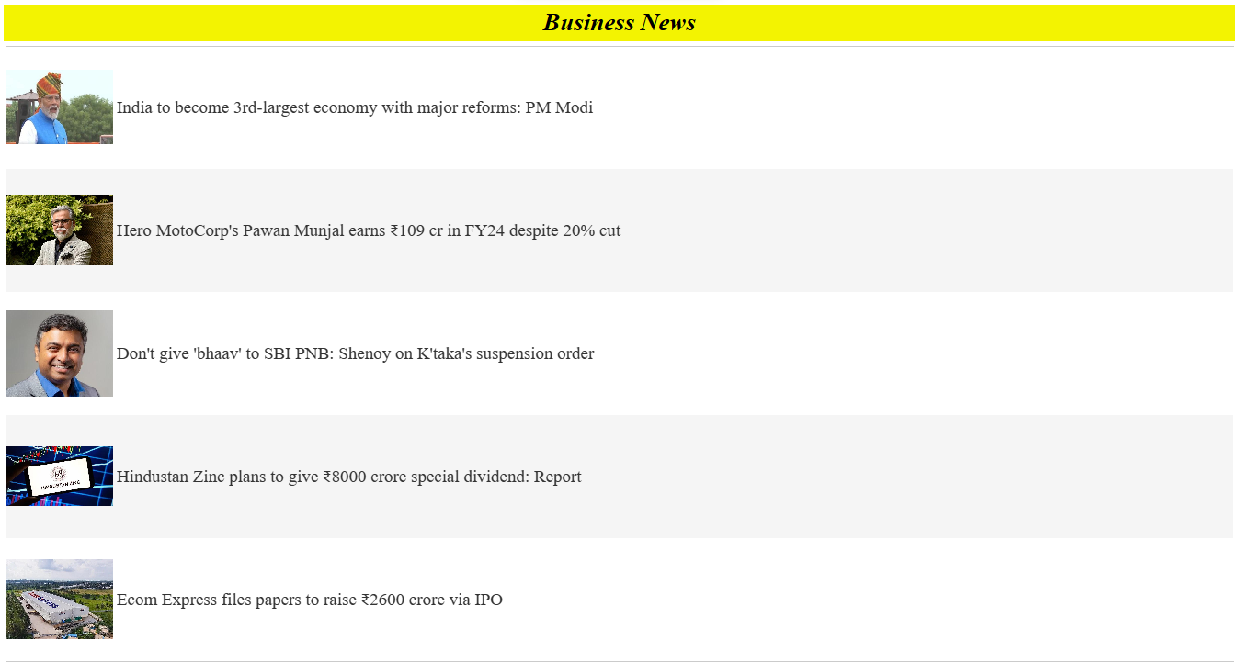
Snapshot of the dashboards

